Slide 1

Stock Price Prediction Using Linear Regression
Mini Project – 1
Ovais Khan

Slide 2
Problem Statement & Goal
Millions of dollars pass hands on the stock market each trading day. In order to make money one must make smart trades.
If we could accurately predict the increase or decrease of a specific security, one could buy and sell at ideal times and maximize profit .
This project proposes a novel method for the prediction of stock closing price, since, profit or loss calculation is usually determined by the closing price of a security for the day, hence we will consider the closing price as the target variable.
We will use learned techniques of Linear Regression, on historical ASX market data, to determine if it can efficiently help in calculating the ASX closing index for a given trading day.

Slide 3
Technical Analysis And Indexes
Tech Analysis is seeing trends develop before the market and then exploiting them. Patterns tend to repeat themselves so we want to identify whether is it good time to buy or sell and TIME THE MARKET.
Indexes aggregate the prices of multiple stocks together, and allow you to see how the market as a whole is performing. For example, the ASX 200 dataset used in the project aggregates the stock prices of 200 largest ASX listed stocks and acts as the benchmark for Australian equity performance.
Predicting whether an index will go up or down will help us forecast how the stock market as a whole will perform. Since stocks tend to correlate with how well the economy as a whole is performing, it can also help us make economic forecasts

Slide 4
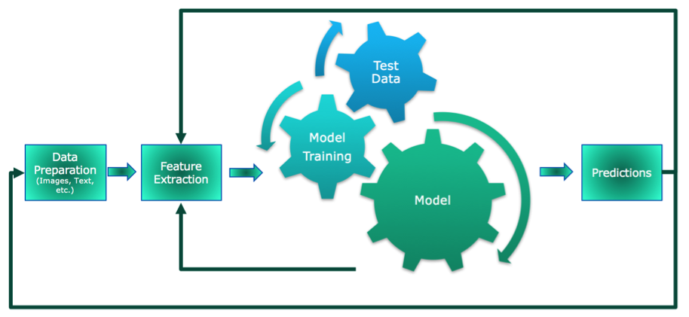
Project workflow

Slide 5
Data Collection & preparation
Utilized web APIs for Yahoo Finance, and EOD Historical Data for ASX 200, to retrieve data in JSON format & parsed it into dataframes
Volume was missing. Replaced volume with data from other sources.
Cleaning tasks with date columns.
The time series nature of the data means that can generate indicators to make our model more accurate. And hence I included Indicators, price differences, percent changes and ratios as separate columns to identify trends.
And since we want the model to learn and predict FUTURE PRICE, based on historical price trends, we remove the current price data when calculating averages, as it will be equivalent to handing the answers to the model upfront, and will make it impossible to use in the "real world", where you don't know the price upfront.
Dropping the remaining null values
Calculating moving averages so that a significant portion of the daily price noise will have been "averaged-out".

Slide 6
Indicators
Price and volume trends are critical to understanding investor sentiment.
Price changes are not just linked to fundamental factors such as dividends, earnings, FCF, risks and growth, which determine if the price is undervalued or overvalued.
Rather it also is linked to investor psychology, and how the investor psychology is linked to market trends and patterns. This is related to mob mentality, where in, when people want to sell, then to oversell, and when people want to buy, they tend to overbuy. So we want to take advantage of the irrational factors that are relevant to pricing the security.
Moving average is a technical analysis technique that smoothes price data by calculating a constantly updating average price and gives a means to relate the price data to determine a trend indicator. The average is taken over a specific period. The period selected depends on the type of movement of interest, such as making a decision in short term (5, 7 and 20 day periods), medium term (30, 50 and 90 days periods) and long term (120, 200 and 1 year periods)

Slide 7
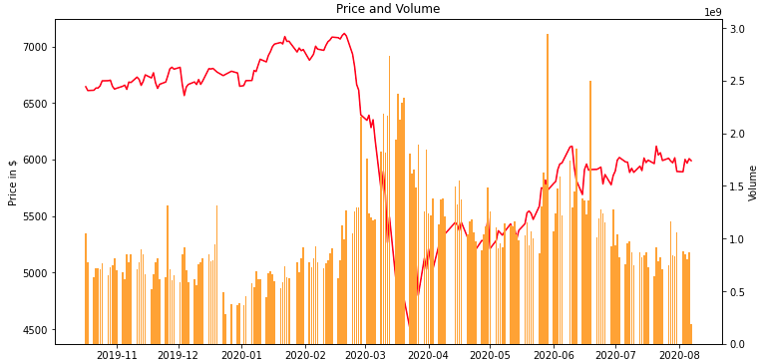
Focus on price and volume
Price – Because of giving the model a benchmark price figure, for support and resistance levels which, if breached indicate upwards or downward trends.
Price Based Indicators - Moving averages of closing prices over different specified time periods. We have to determine, when we have a bullish indicator and bearish indicator. Exponential means, greater emphasis is placed on recent prices. A bullish indicator may be when a short term MA crosses over a long term MA from underneath. Similarly, a bearish indicator may be when, a long term MA crosses the short term MA from above.
If volume is high and price is rising, then its a bull signal, and if price is rising and the volume is low, then the demand is going to taper off soon, and may be its time to sell, so this may be a bear signal. Conversely if the price is falling, and is there is high volume, then it is a bearish indicator and if the price is falling but the volume is low, then its a bullish indicator.

Slide 8
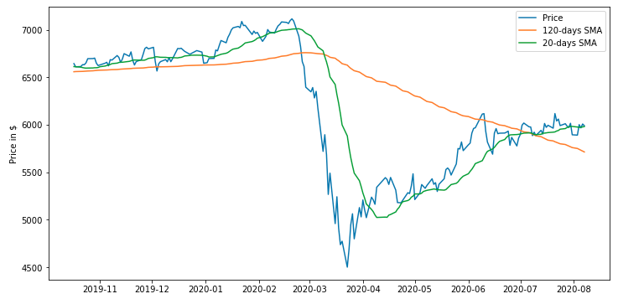
AN EXAMPLE OF UPWARD AND DOWNWARD TRENDS

Slide 9
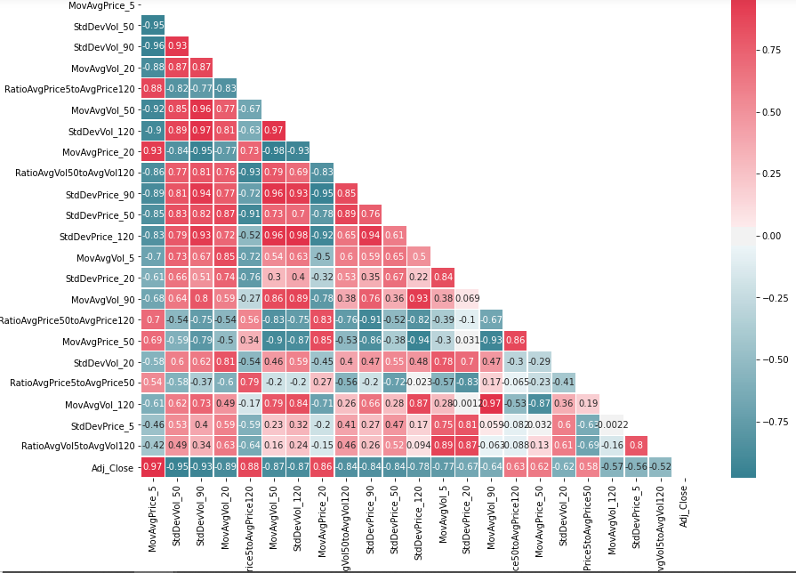
Feature selection - correlation

Slide 10
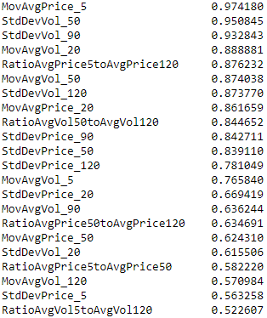
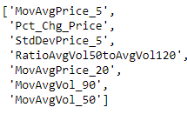
Feature selection – ff selection

Slide 11
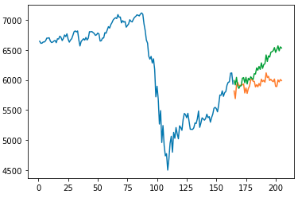
Model predictions
Determining the price is always challenging and as we can see there is divergence between predictions and actual price.
We need to employ some other advanced techniques like XGBoost and LSTM models to see if that improves predictability.
When the model predicted a decrease, the price decreased 83.33% of the time
When the model predicted a increase, the price increased 78.26% of the time

Slide 12
Future improvements
Included sentiment analysis from news feed and Twitter
Speak to domain experts to include better indicators.
Applying other techniques (cross validaton etc…) for further feature optimization, and employing other machine learning models like Random Forest, LSTM and XGBoost and comparing the results.
Increase number of observations

